Slide 1
CPSC 331, Tutorial #14 Questions 1 & 2
Taken from CPSC 331 course material

Slide 2
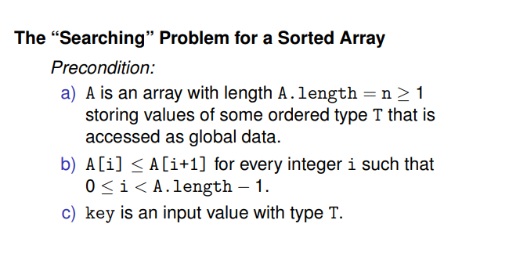
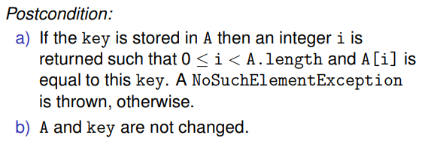
Background: searching sorted array

Slide 3
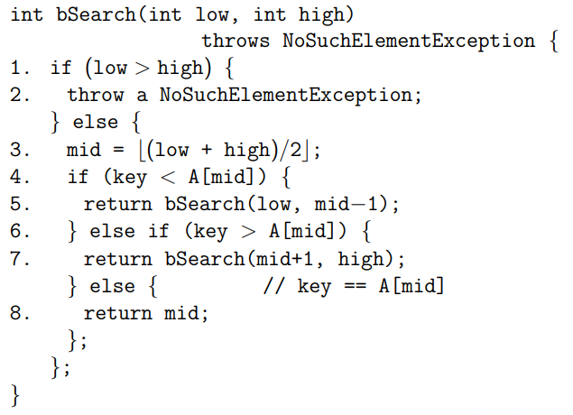
Background: binary search algorithm #1

Slide 4

Slightly modified question 1) Trace
Trace the execution of bSearch algorithm using the following inputs:
Array 1:
Key = 2
Array 2:
Key = 0
0 1 2 3 4 5 6 7 8 9 10 11 12 13 14 15
0
0
0
0
0
0
0
0
0
0
0
0
0
0
0
0

Slide 5
Slightly modified question 1) Trace
A and Key are global variable.
Execution #0:
Key is 2
Low = 0
High = 9
L
H

Slide 6
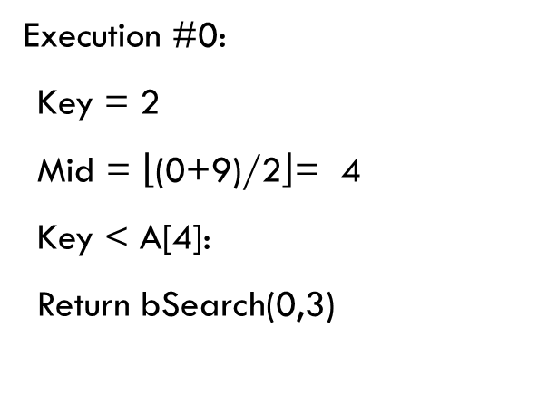
Slightly modified question 1) Trace
L
M
H
Execution #0:
Key = 2
Mid = $\left\lfloor \text{(0+9)/2}\right\rfloor$= 4
Key < A[4]:
Return bSearch(0,3)

Slide 7
Slightly modified question 1) Trace
Execution #1:
Key is 2
Low = 0
High = 3
L
H

Slide 8
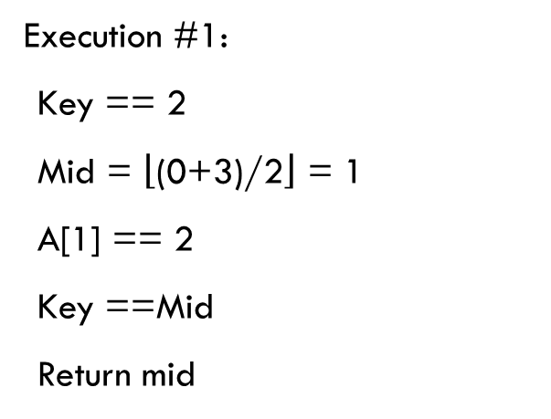
Slightly modified question 1) Trace
L
M
H
Execution #1:
Key == 2
Mid = $\left\lfloor \text{(0+3)/2}\right\rfloor$ = 1
A[1] == 2
Key ==Mid
Return mid

Slide 9
Slightly modified question 1) Trace
0 1 2 3 4 5 6 7 8 9 10 11 12 13 14 15
0
0
0
0
0
0
0
0
0
0
0
0
0
0
0
0
L
A and Key are global variable.
Execution #0:
Key is 0
Low = 0
High = 15
H

Slide 10

Slightly modified question 1) Trace
0 1 2 3 4 5 6 7 8 9 10 11 12 13 14 15
0
0
0
0
0
0
0
0
0
0
0
0
0
0
0
0
L
Execution #0:
Key == 0
Mid = $\left\lfloor \text{(0+15)/2}\right\rfloor$ = 7
A[7] == 0
A[Mid] == key
Return 7
H
M

Slide 11
Background: bsearch2 algorithm
Consider a version of Binary Search that achieves a bit more than the one discussed in Lecture #15:
When array entries are not unique and there is more than one index i such that the key is found at position i in the sorted array or ArrayList, then the smallest index i for which this is true is returned.

Slide 12
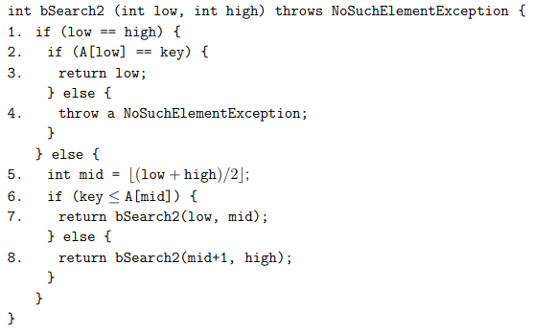
Background: bsearch2 algorithm
Additional pre-condition:
0 ≤ low ≤ high ≤ A.length − 1.

Slide 13
Slightly modified question 2) Trace
Trace the execution of bSearch2 algorithm using the following inputs:
Array 1:
Key = 2
Array 2:
Key = 0
0 1 2 3 4 5 6 7 8 9 10 11 12 13 14 15
0
0
0
0
0
0
0
0
0
0
0
0
0
0
0
0

Slide 14
Slightly modified question 2) Trace
A and Key are global variable.
Initially:
A is shown above.
Key is 2.
Low = 0
High = 9
L
H

Slide 15

Slightly modified question 2) Trace
Key is 2.
Low < high
Mid = $\left\lfloor \text{(0+9)/2}\right\rfloor$ = 4
A[4] == 21
Key < 21
bSearch2(0, 4)
L
M
H

Slide 16
Slightly modified question 2) Trace
A and Key are global variable.
A is shown above.
Key is 2.
Low = 0
High = 4
L
H

Slide 17

Slightly modified question 2) Trace
Key is 2.
Low < high
Mid = $\left\lfloor \text{(0+4)/2}\right\rfloor$ = 2
A[2] == 6
Key < 6
bSearch2( 0, 2)
L
M
H

Slide 18
Slightly modified question 2) Trace
A and Key are global variable.
A is shown above.
Key is 2.
Low = 0
High = 2
L
H

Slide 19

Slightly modified question 2) Trace
Key is 2.
Low < high
Mid = $\left\lfloor \text{(0+2)/2}\right\rfloor$ = 1
A[1] == 2
Key <= 2
bSearch2( 0, 1)
L
M
H

Slide 20
Slightly modified question 2) Trace
A and Key are global variable.
A is shown above.
Key is 2.
Low = 0
High = 1
L
H

Slide 21

Slightly modified question 2) Trace
Key is 2.
Low < high
Mid = $\left\lfloor \text{(0+1)/2}\right\rfloor$ = 0
A[0] == -3
Key > -3
bSearch2( 1, 1)
L
H
M

Slide 22
Slightly modified question 2) Trace
A and Key are global variable.
A is shown above.
Key is 2.
Low = 1
High = 1
H
L

Slide 23
Slightly modified question 2) Trace
Key is 2.
Low < high
Mid = $\left\lfloor \text{(0+1)/2}\right\rfloor$ = 0
A[0] == -3
Key > -3
bSearch2( 1, 1)
H
L

Slide 24
Slightly modified question 2) Trace
0 1 2 3 4 5 6 7 8 9 10 11 12 13 14 15
0
0
0
0
0
0
0
0
0
0
0
0
0
0
0
0
L
A and Key are global variable.
Execution #0:
A is shown above.
Key is 0.
Low = 0
High = 15
H

Slide 25

Slightly modified question 2) Trace
0 1 2 3 4 5 6 7 8 9 10 11 12 13 14 15
0
0
0
0
0
0
0
0
0
0
0
0
0
0
0
0
L
Execution #0:
Key is 0.
Low < high
Mid = $\left\lfloor \text{(0+15)/2}\right\rfloor$ = 7
A[7] == 0
Key <= 0
bSearch2(0, 7)
H
M

Slide 26
Slightly modified question 2) Trace
0 1 2 3 4 5 6 7 8 9 10 11 12 13 14 15
0
0
0
0
0
0
0
0
0
0
0
0
0
0
0
0
L
H
Execution #1:
Key is 0
Low = 0
High = 7

Slide 27

Slightly modified question 2) Trace
0 1 2 3 4 5 6 7 8 9 10 11 12 13 14 15
0
0
0
0
0
0
0
0
0
0
0
0
0
0
0
0
L
M
H
Execution #1:
Key is 0.
Low < high
Mid = $\left\lfloor (\text{0+7)/2}\right\rfloor$ = 3
A[3] == 0
Key <= 0
bSearch2(0, 3)

Slide 28
Slightly modified question 2) Trace
0 1 2 3 4 5 6 7 8 9 10 11 12 13 14 15
0
0
0
0
0
0
0
0
0
0
0
0
0
0
0
0
L
H
Execution #2:
Key is 0
Low = 0
High = 3

Slide 29

Slightly modified question 2) Trace
0 1 2 3 4 5 6 7 8 9 10 11 12 13 14 15
0
0
0
0
0
0
0
0
0
0
0
0
0
0
0
0
L
M
H
Execution #2:
Key is 0.
Low < high
Mid = $\left\lfloor \text{(0+3)/2}\right\rfloor$ = 1
A[1] == 0
Key <= 0
bSearch2( 0, 1)

Slide 30
Slightly modified question 2) Trace
0 1 2 3 4 5 6 7 8 9 10 11 12 13 14 15
0
0
0
0
0
0
0
0
0
0
0
0
0
0
0
0
L
H
Execution #3:
Key is 0
Low = 0
High = 1

Slide 31

Slightly modified question 2) Trace
0 1 2 3 4 5 6 7 8 9 10 11 12 13 14 15
0
0
0
0
0
0
0
0
0
0
0
0
0
0
0
0
L
H
Execution #3:
Key is 0.
Low < high
Mid = $\left\lfloor \text{(0+1)/2}\right\rfloor$ = 0
A[0] == 0
Key <= 0
bSearch2( 0, 0)
M

Slide 32
Slightly modified question 2) Trace
0 1 2 3 4 5 6 7 8 9 10 11 12 13 14 15
0
0
0
0
0
0
0
0
0
0
0
0
0
0
0
0
L
Execution #4:
Key is 0.
Low = 0
High = 0
H

Slide 33
Slightly modified question 2) Trace
0 1 2 3 4 5 6 7 8 9 10 11 12 13 14 15
0
0
0
0
0
0
0
0
0
0
0
0
0
0
0
0
L
Execution #4:
Key is 0.
Low == high
Return 0
This is, indeed, the smallest
integer i between 0 and 15 such that A[i] = 0
H

